Slide 1


Slide 2
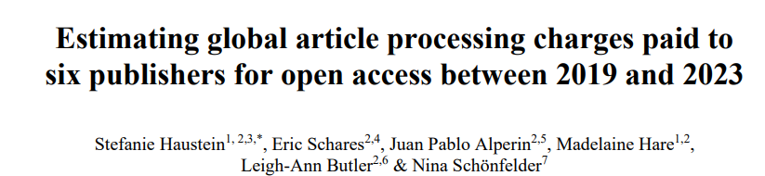
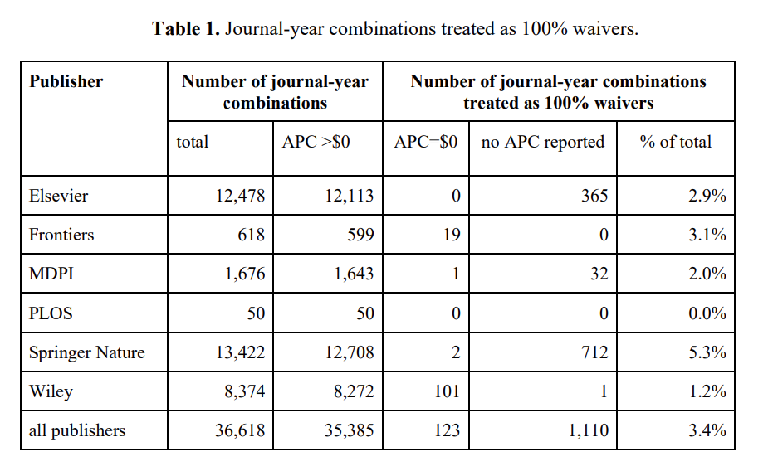
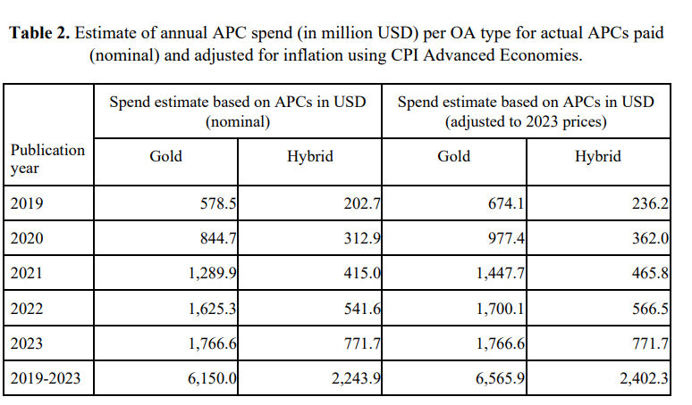
Notes:
Gold = open access to everyone, immediately upon publication
Hybrid = subscription-based journal with option on open access

Slide 3
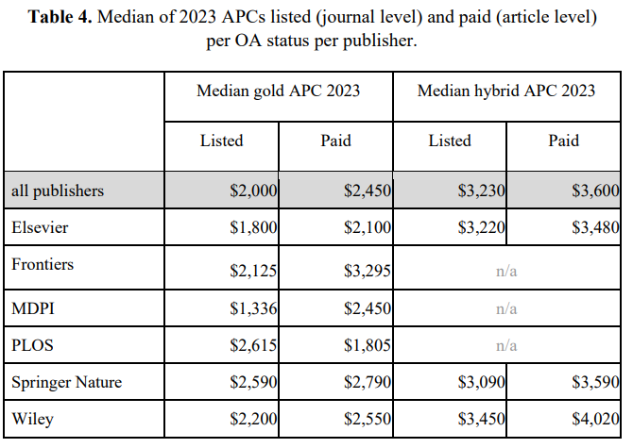
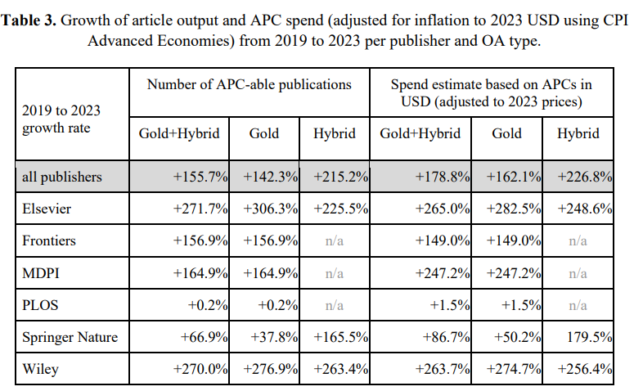

Slide 4
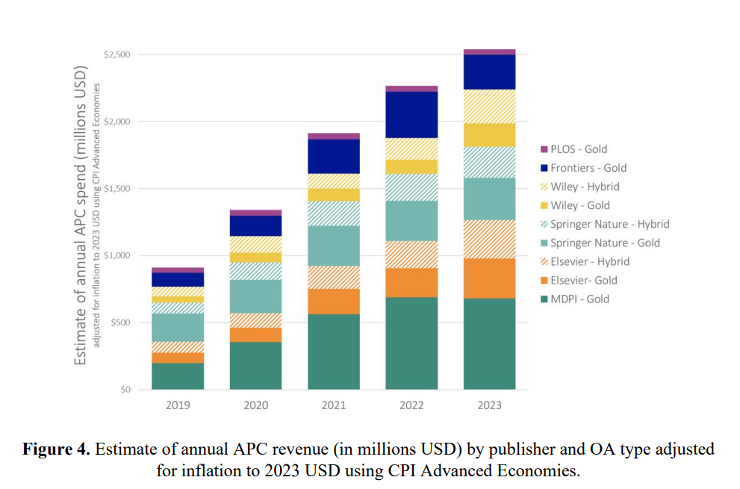

Slide 5
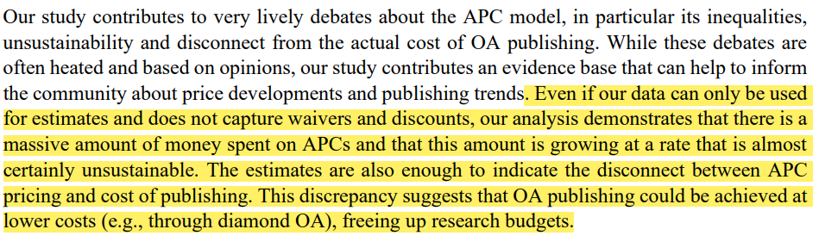
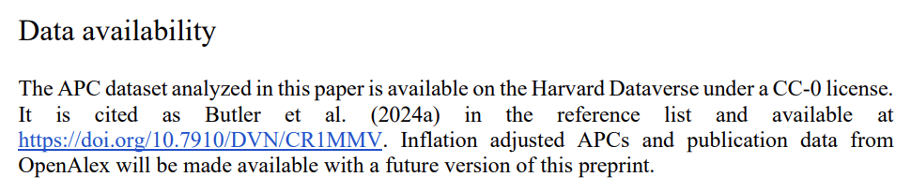
Notes:
Struggle to pay these fees
Lucrative and profitable for publishers
Challenge for DOP for sustainability
APC (article processing charge)

Slide 6
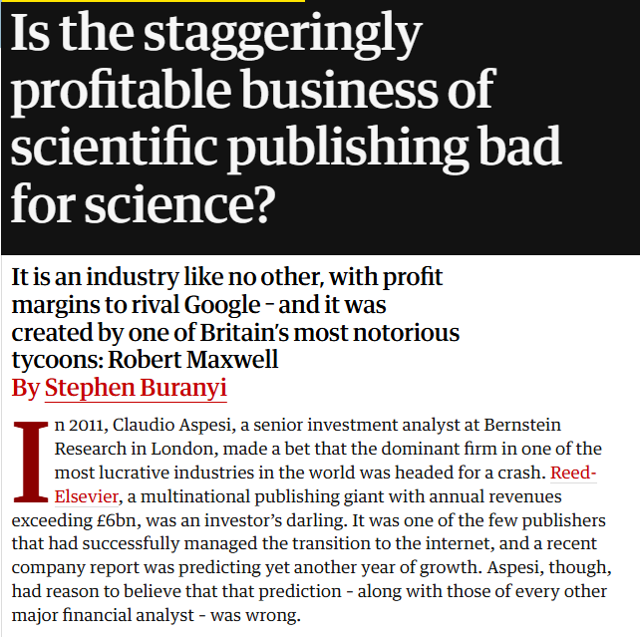

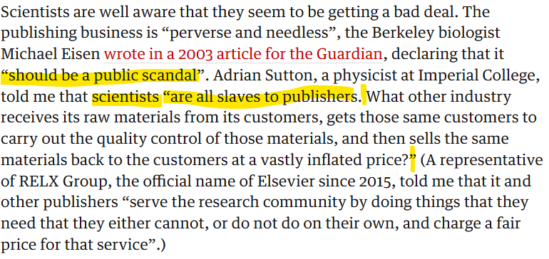
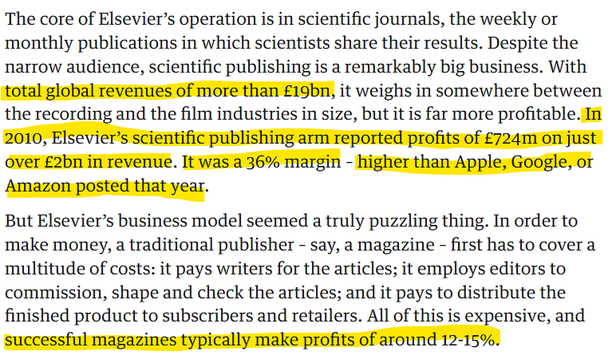
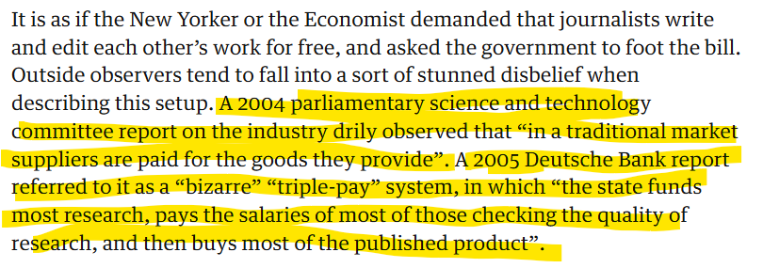

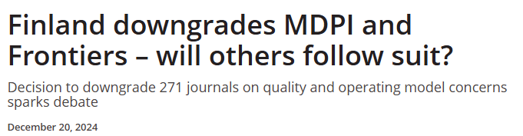
I saw this tweet some weeks ago…

Slide 7
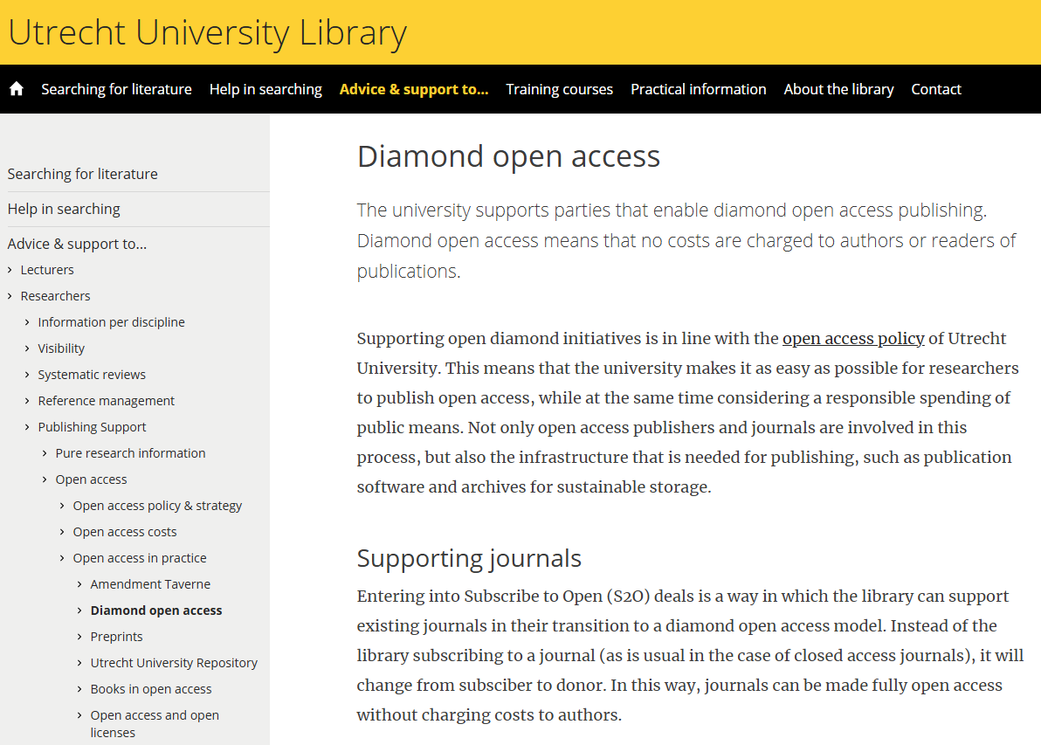

Slide 8
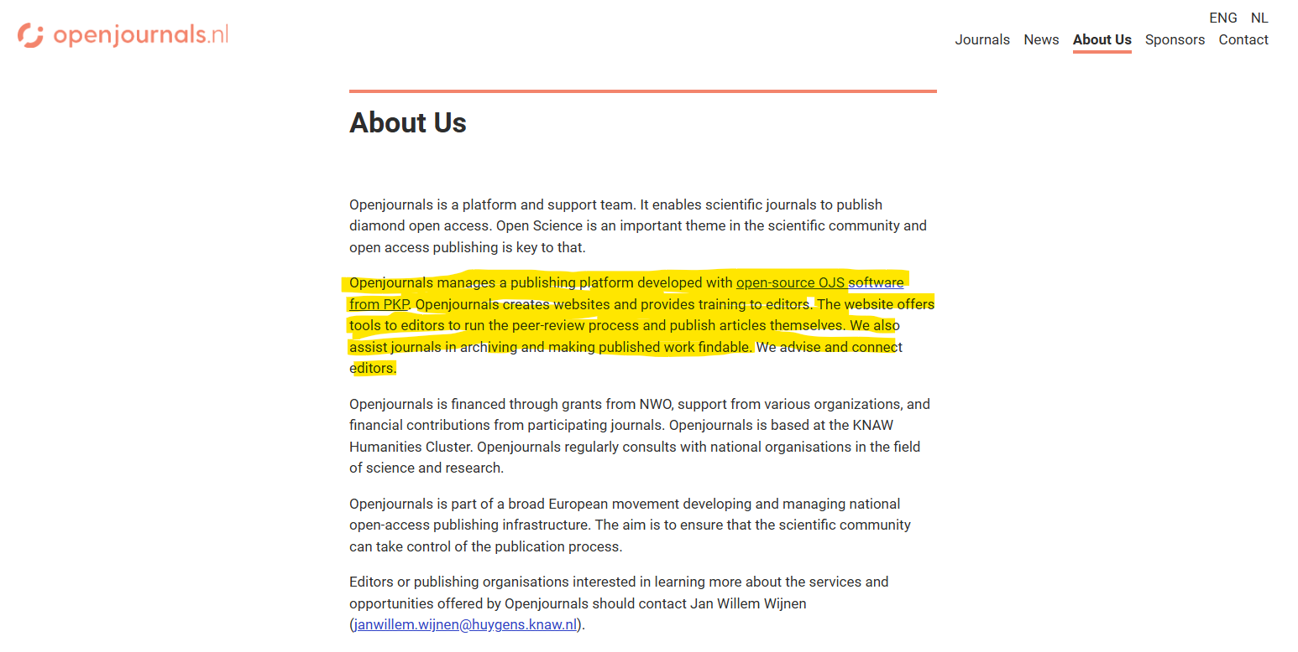
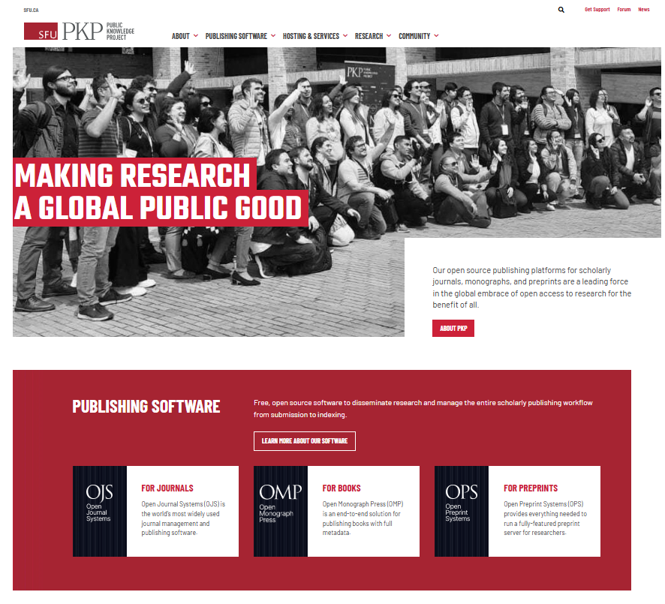



Slide 9

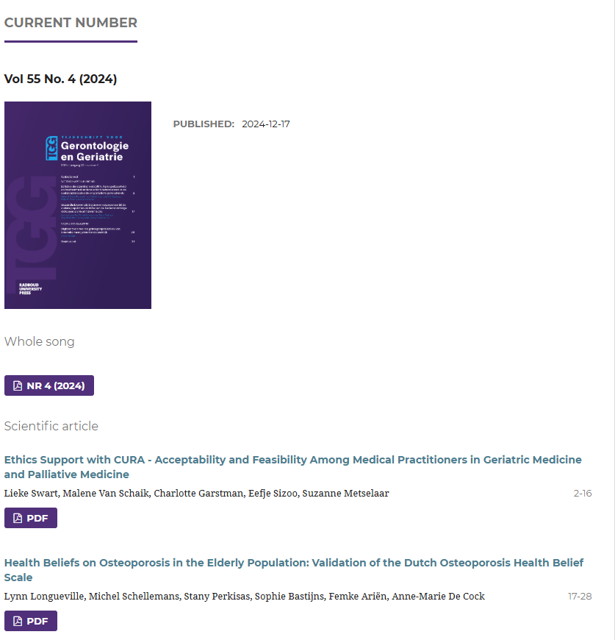

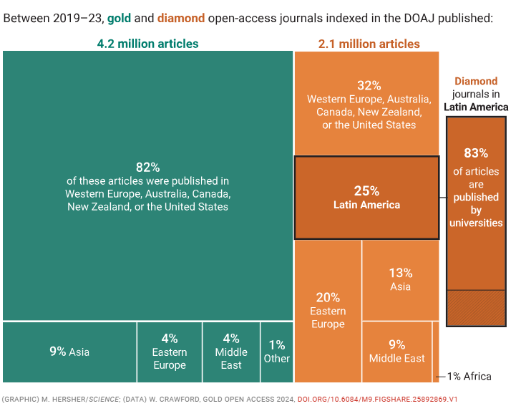

Slide 10
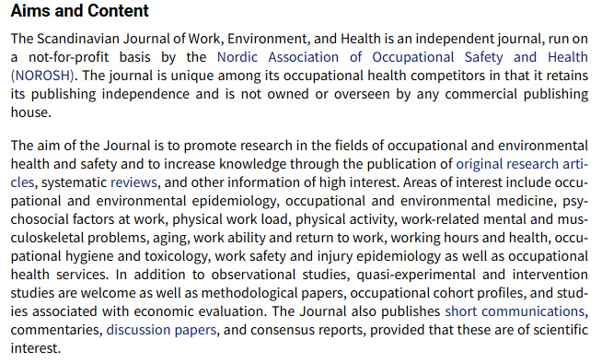
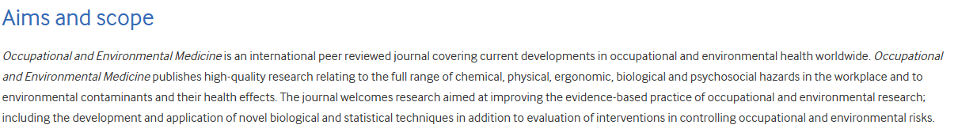
Other reasons to create this, despite the typical ones:

Slide 11
Diamond Open Access Journal
Exposure and Health in the Workplace
https://github.com/UtrechtUniversity/DOA-journal-occupational

Slide 12


Key principles
01
04
BRIDGES
OPEN
Between academia and the applied sectors
Data and code sharing, computational tutorials.
02
03
REPRESENTATIVE
FLEXIBLE
Low- and middle-income countries, early career stages
Open peer-review with opt-out options (remain anonymous). Crowd peer-review
Notes:
A forum/open room not only for researchers but also to strengthen the link between academia and the more applied world (practitioners, consultants, stakeholders).
Include researchers from low- and middle-income countries as well as others.
Provide young researchers, including BSc and MSc students, with opportunities to enhance their work (e.g., WAs, projects).
Enable discussions among young researchers.
Introduce optional open peer review, with a live option (e.g., on Twitch) where everyone can attend and participate, as well as a non-live option (following forum standards supervised by elected peer reviewers).
Include a peer-review query system where reviewers can see a list of papers they would like to review.
Develop a mobile version to make the platform more accessible.
Offer prizes or symbolic presents for the best reviews every year or six months (e.g., low-budget awards and news dedications on the homepage).

Slide 13
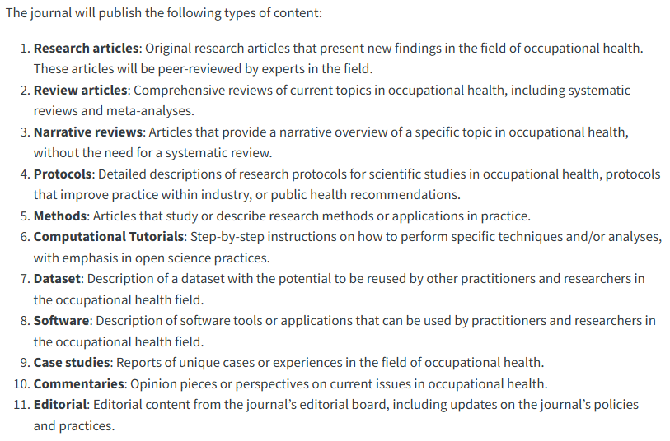
Types of Contents
Notes:
For more a scientific content:
Include case studies in occupational hygiene (sharing experiences, practices, and results from the field).
Publish commentaries such as opinion pieces, perspectives, debates, and journal clubs on current issues in occupational health.
Allow data and code (including R packages) to be published separately (e.g., on GitHub, Dataverse, or Zenodo).
Facilitate discussions on common and good practices, as well as standards for improving workplace health, based on guidance from agencies, institutes, or industries (e.g., CropLife’s guidance on ‘Chemical Exposure Assessment and Control During the Manufacturing Process’).

Slide 14
ALL OF THIS FOR ONLY
EXPENSES
Openjournals.nl | $2,400/year
Toni, Javier, Sewon, Max, Wenxin | $0
Authors | $0
Reviewers | $0
COSTS
TOTAL
2,400 EUR / year

Slide 15
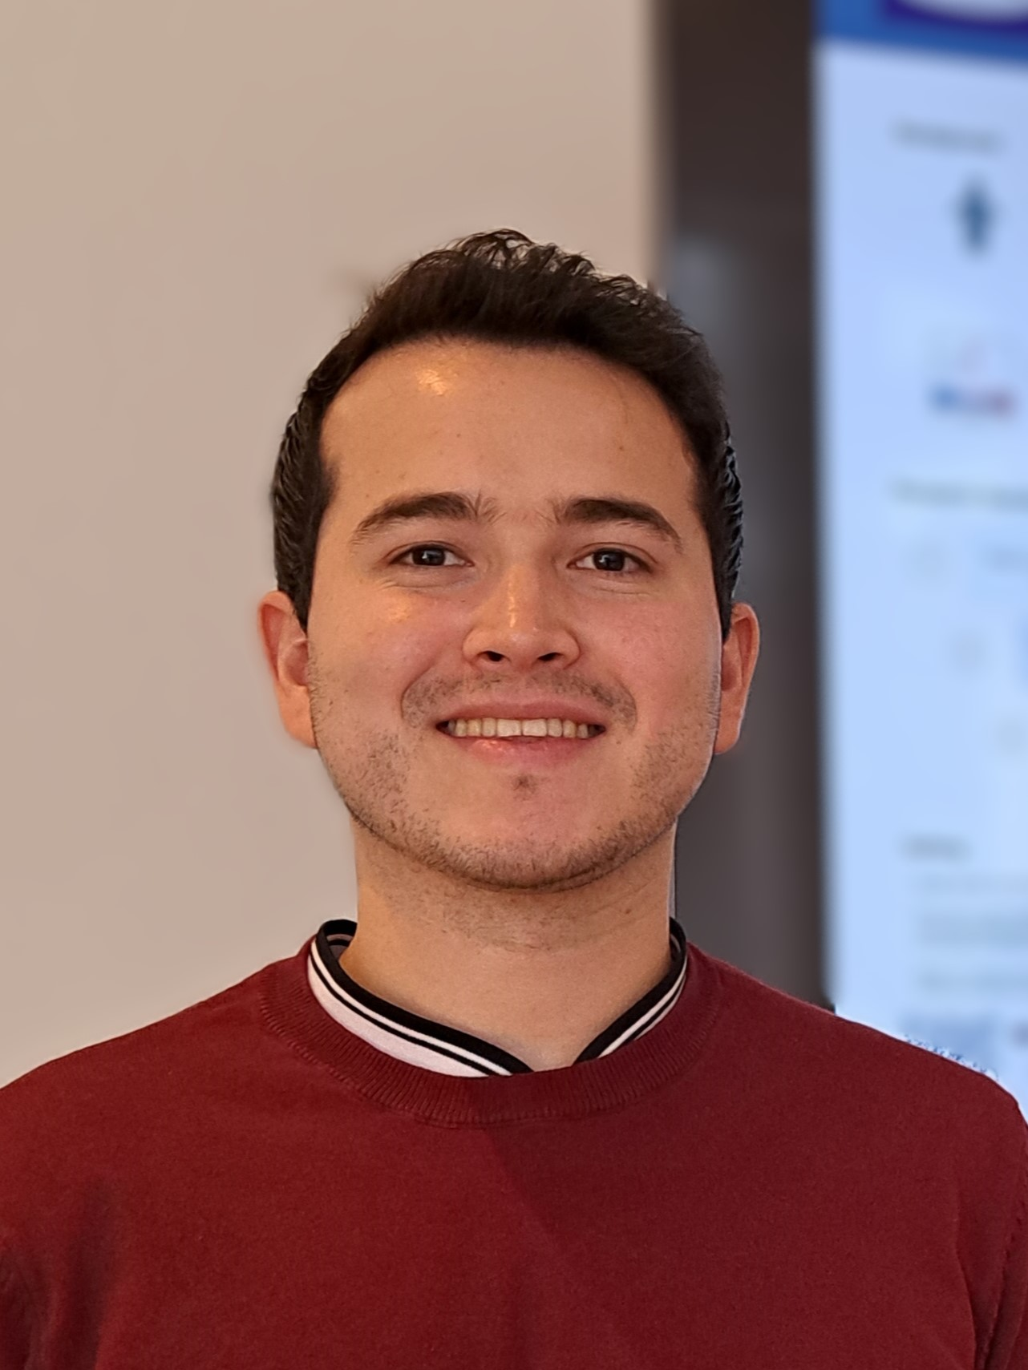




Thank you!
Let us know what you think.
Toni D’Errico
Postdoctoral researcher IRAS
Peer Reviewer for multiple journals
Javier Mancilla Galindo
Junior researcher IRAS
Affiliate medRxiv: the pre-print server for Health Sciences
Co-founder: Critical Care and Emergency Medicine journal

